Slide 1

DevOps
Definition
Features
DevOps is a set of practices that combines software development (Dev) and IT operations (Ops) to shorten the systems development lifecycle and provide continuous delivery with high software quality.
DevOps features include continuous integration and delivery (CI/CD), automation, infrastructure as code (IaC), monitoring and logging, collaboration, and rapid feedback loops.
Advantages
Disadvantages
DevOps accelerates software delivery, improves collaboration between teams, enhances product quality, reduces deployment failures, and fosters innovation through faster feedback.
Disadvantages of DevOps include potential culture clashes, the need for extensive training, initial setup complexity, and possible over-reliance on automation.

Slide 2
How DevOps Works?
Planning
1
The DevOps lifecycle begins with planning, where the team defines the project scope, goals, and requirements.
2
Coding
Developers write and test code, using version control systems to track changes and collaborate efficiently.
Building
3
The code is compiled and packaged into a deployable artifact, often using automated build tools and pipelines.
4
Testing
Automated tests are run to ensure the code meets quality standards and functionality requirements.
Deployment
5
The code is deployed to production environments, using automated tools and pipelines to ensure a smooth and consistent process.
6
Monitoring
Continuous monitoring tracks application performance, infrastructure health, and user feedback, providing insights for improvement.
Feedback
7
Feedback from monitoring and user experience helps to identify areas for improvement and guide future development efforts.

Slide 3
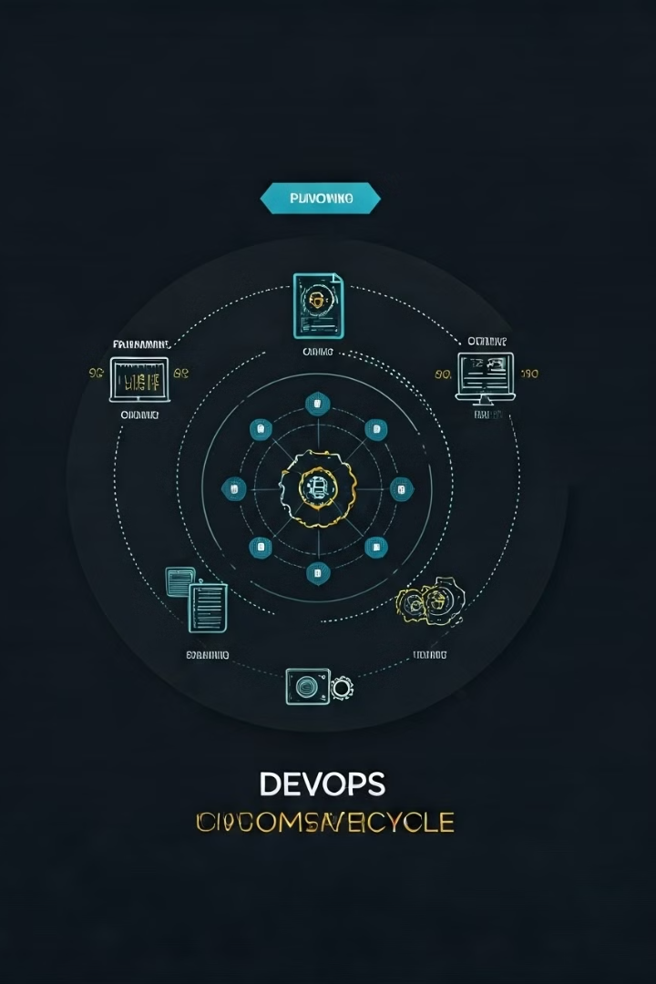
Lifecycle of DevOps
1. Planning
Definition: In this phase, teams define project goals, requirements, and specifications.
Activities:
Identifying user needs and product features.
Creating a roadmap and prioritizing tasks.
Collaborating across teams to align on objectives.
2. Development
Definition: This stage involves writing and building the actual code based on the defined specifications.
Activities:
Developers create application code and functionalities.
Version control systems (e.g., Git) are used to track changes and manage code.
Continuous integration practices are employed to integrate code changes frequently.

Slide 4
Lifecycle of DevOps
3. Integration
Definition: Code changes are automatically integrated and tested to ensure quality.
Activities:
Using CI/CD tools (e.g., Jenkins, GitLab CI) to automate testing and integration processes.
Running automated tests to validate code against requirements.
Ensuring that the application is stable and ready for deployment.
4. Testing
Definition: The application undergoes rigorous testing to identify defects or issues before release.
Activities:
Executing automated and manual tests, including unit tests, integration tests, and performance tests.
Gathering feedback from testers and making necessary adjustments.
Validating security and compliance requirements.

Slide 5
Lifecycle of DevOps
5. Deployment
Definition: The application is released to production or pre-production environments.
Activities:
Automating deployment processes to various environments (staging, production).
Using containerization (e.g., Docker) and orchestration tools (e.g., Kubernetes) for deployment.
Monitoring deployment metrics to ensure success.
6. Monitoring
Definition: Continuous monitoring of the application in production to ensure optimal performance and reliability.
Activities:
Utilizing monitoring tools (e.g., Prometheus, Grafana) to track application performance and user behavior.
Gathering logs and metrics to detect anomalies or issues.
Analyzing system performance and user feedback.

Slide 6
Lifecycle of DevOps
7. Feedback
Definition: Gathering insights and feedback from users and stakeholders to inform future development.
Activities:
Collecting user feedback through surveys, analytics, and support tickets.
Conducting post-mortem analysis of incidents or outages to identify improvement areas.
Iterating on the product based on insights gathered.
8. Continuous Improvement
Definition: Implementing changes based on feedback and monitoring results to enhance the development process.
Activities:
Identifying bottlenecks and areas for optimization in the workflow.
Adopting new tools and technologies to improve efficiency.
Training teams on best practices and emerging methodologies.

Slide 7

All Popular DevOps Tools
Version Control: Git, GitHub, Bitbucket
CI/CD: Jenkins, GitLab CI, CircleCI, Travis CI, GitHub Action
Configuration Management: Ansible, Puppet, Chef
Infrastructure as Code: Terraform
Containerization: Docker, Kubernetes
Monitoring: Prometheus, Grafana, ELK Stack (Elasticsearch, Logstash, Kibana)
Collaboration: Slack, Microsoft Teams, Jira

Slide 8

Why DevOps?
History of DevOps
Organizations adopt DevOps to improve software delivery speed, enhance product quality, foster a culture of collaboration, and respond more effectively to customer needs. It allows businesses to innovate faster and maintain a competitive edge.
DevOps originated in the late 2000s as a response to the challenges faced in software development and IT operations. The term "DevOps" was popularized in 2009 by Patrick Debois, who organized the first DevOpsDays event. Since then, the practice has evolved with the growth of Agile methodologies and cloud computing, leading to a broader adoption of continuous integration and deployment practices.

Slide 9

Best Practices for Effective DevOps
Foster a Collaborative Culture: Encourage teamwork and communication between development and operations teams.
Implement CI/CD Pipelines: Automate the build, test, and deployment processes.
Embrace Infrastructure as Code: Use code to manage and provision infrastructure.
Monitor Performance: Continuously monitor applications and infrastructure to identify issues proactively.
Regularly Collect Feedback: Use user feedback to inform future development cycles and improve products.

Slide 10
DevOps vs SRE
Feature | DevOps | Site Reliability Engineering (SRE)
Definition | A cultural and professional movement aimed at improving collaboration between development and operations teams. | A discipline that incorporates aspects of software engineering and applies them to infrastructure and operations to create scalable and highly reliable software systems.
Focus | Emphasizes collaboration, automation, and continuous delivery. | Focuses on reliability, scalability, and uptime of services through engineering practices.
Primary Goals | Deliver software faster and improve deployment frequency. | Ensure service reliability and performance while managing risk.
Team Structure | Often involves cross-functional teams that include developers, QA, and operations. | Typically involves specialized SRE teams that focus on monitoring, incident response, and reliability engineering.
Metrics | Measures success through deployment frequency, lead time, and change failure rate. | Measures success through service level indicators (SLIs), service level objectives (SLOs), and error budgets.
Approach to Risk | Encourages frequent releases with a focus on collaboration and communication. | Balances risk with reliability; uses error budgets to manage feature releases.
Tools and Technologies | Uses a wide range of tools for CI/CD, automation, and monitoring. | Uses engineering practices to build and maintain operational tools; focuses on observability and monitoring.
Cultural Aspect | Fosters a culture of collaboration and shared responsibility. | Promotes a culture of reliability and accountability, often with a strong emphasis on incident response.

